Slide 1
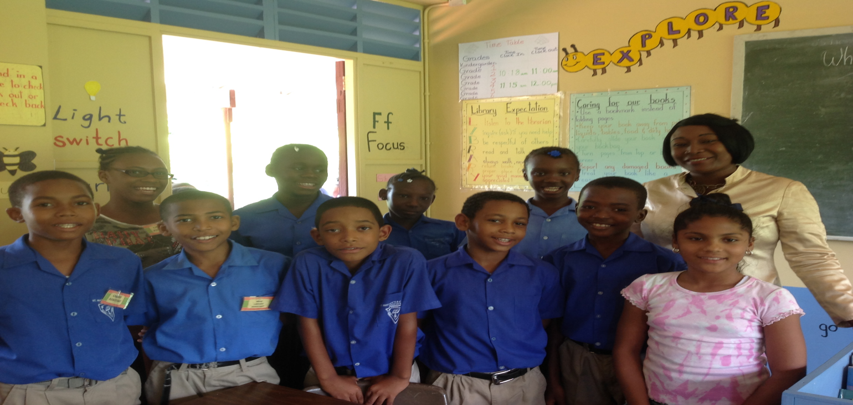
Hands Across the Sea
Student Librarians Programme
Notes:
Birch Grove Roman Catholic

Slide 2
What is the Hands Student Librarians Programme?
This is an imitative encouraged by Hands Across the Sea, to allow students to take ownership of the operation of the school’s library. The program allows students to cultivate leadership and organisational skills while teaching responsibility and how to work as a team.
The main objective of the programme is to promote the sustainability of the library.

Slide 3

Why have student librarians?
Makes it easier for the librarian or library teacher to carry out the library’s programmes.

Slide 4
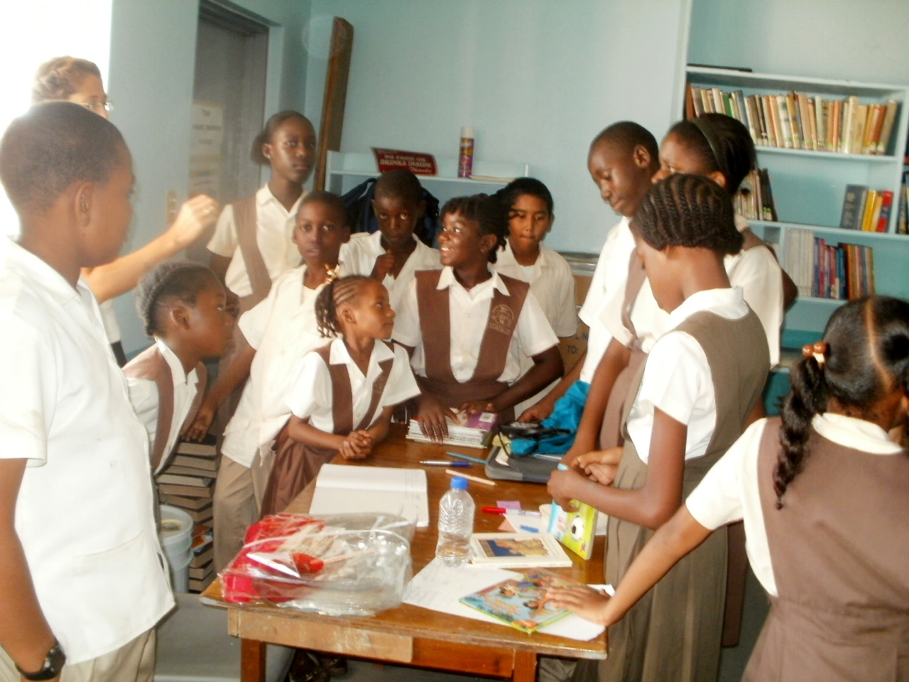
Why have student librarians?
Allows the school management to view the library through the eyes of the students.
Helps generate more interest in the library.
Makes it easier to keep the library opened.

Slide 5
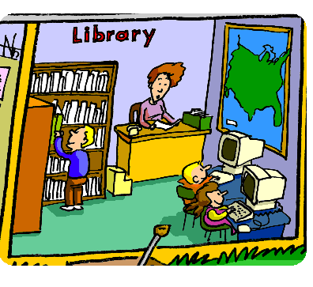
Different Parts of the LIbrary
Bag Check-in-Leave all bags and books. No ice pops, open drinks or food.
Circulation Desk- Check books out and in. Students return books here to the librarian. Direct students to the different sections. Keeps track of how many children in the library at a given time. No more than 15 students.

Slide 6
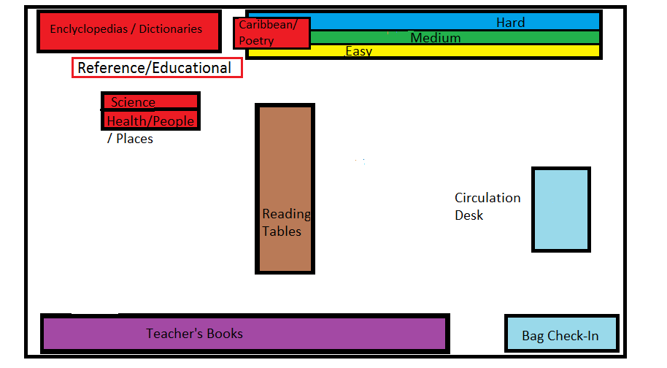
How is the Library Organized?
Circulation Desk
Teacher Section
Student Section
Reference
Books Displays
Science/Health
History/Culture
Caribbean Literature
Reading Tables
Bag Check-in

Slide 7
Classifying Books
Books can be sorted into different categories. Put fiction and non-fiction together and sort them into five different groups.
Level 1 (K-Grade1)
Level 2 (Grades 2,3 and 4)
Level 3 (Grades 5 and 6)
Reference
Teachers

Slide 8
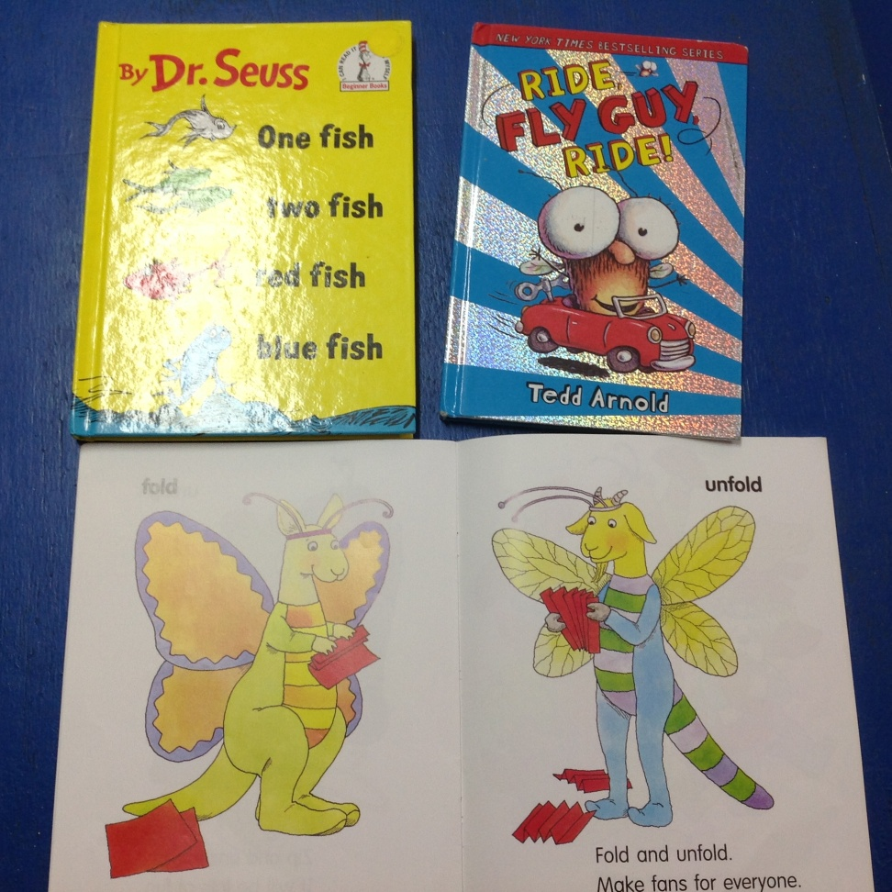
Classifying Books
Level 1: Yellow
Kindergarten and Grade 1
Large letters
Few words on each page
Lots of pictures

Slide 9

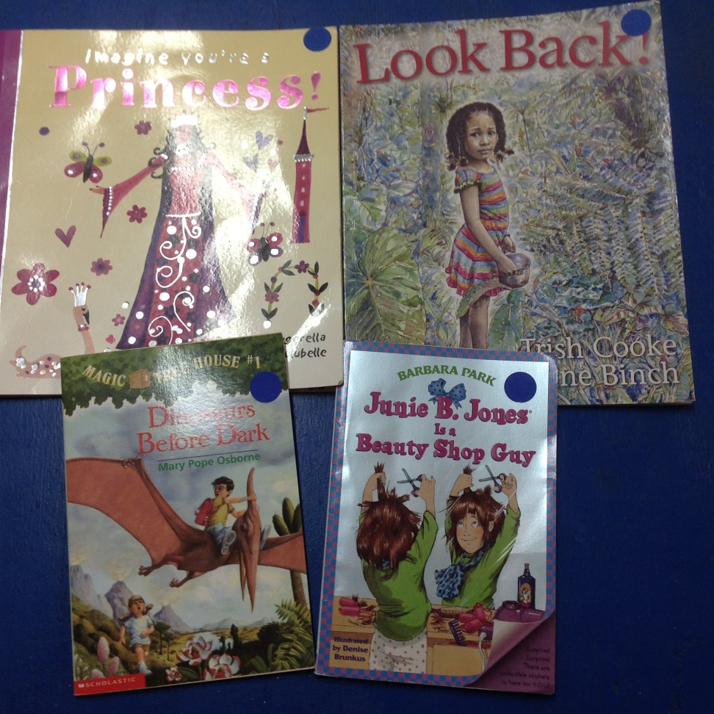
Classifying Books
Level 2
Level 2 Blue
Grades 2, 3 and 4
. Several sentences,
. Medium letter size
. Fewer pictures
. Short chapter books

Slide 10
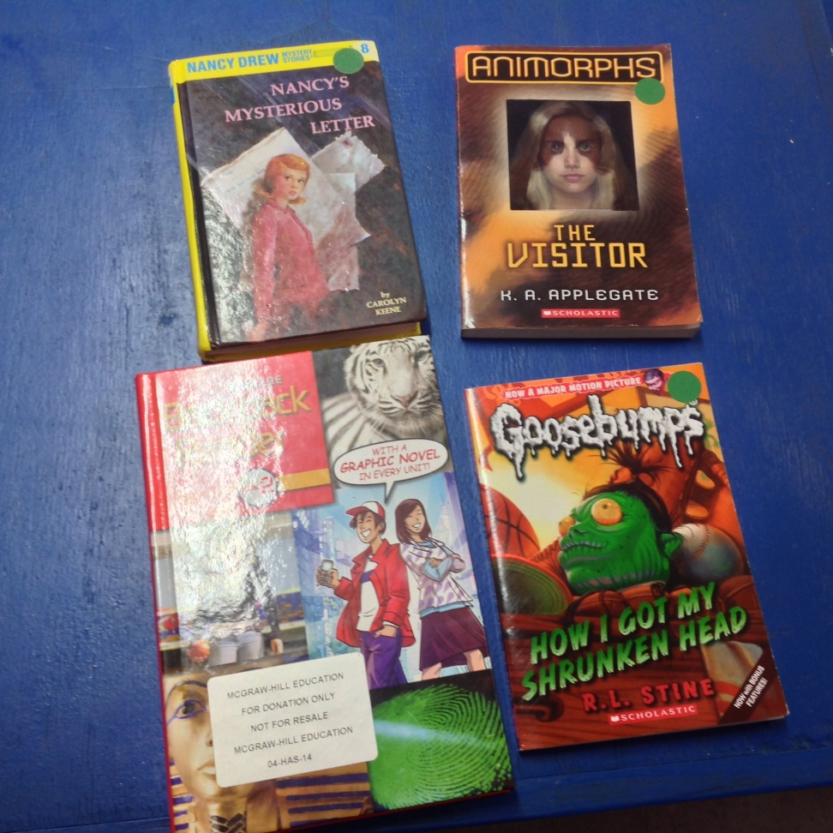
Classifying Books
Level 3 Green
Grades 5 and 6
. Full pages of small letter sizes
. More advanced vocabulary
. Generally no pictures

Slide 11
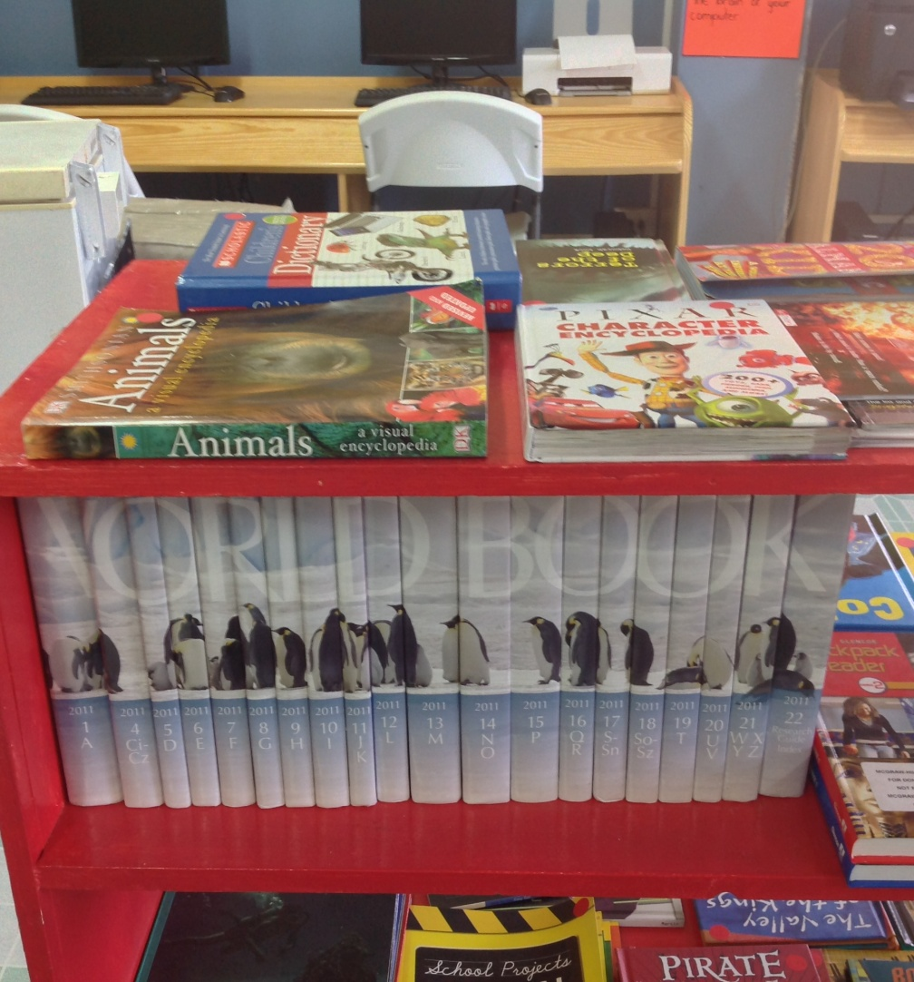
Classifying Books
Reference
Books that the students are not allowed to take home.
Mainly nonfiction books covering a wide variety of topics
Encyclopaedias, dictionaries and atlases.

Slide 12
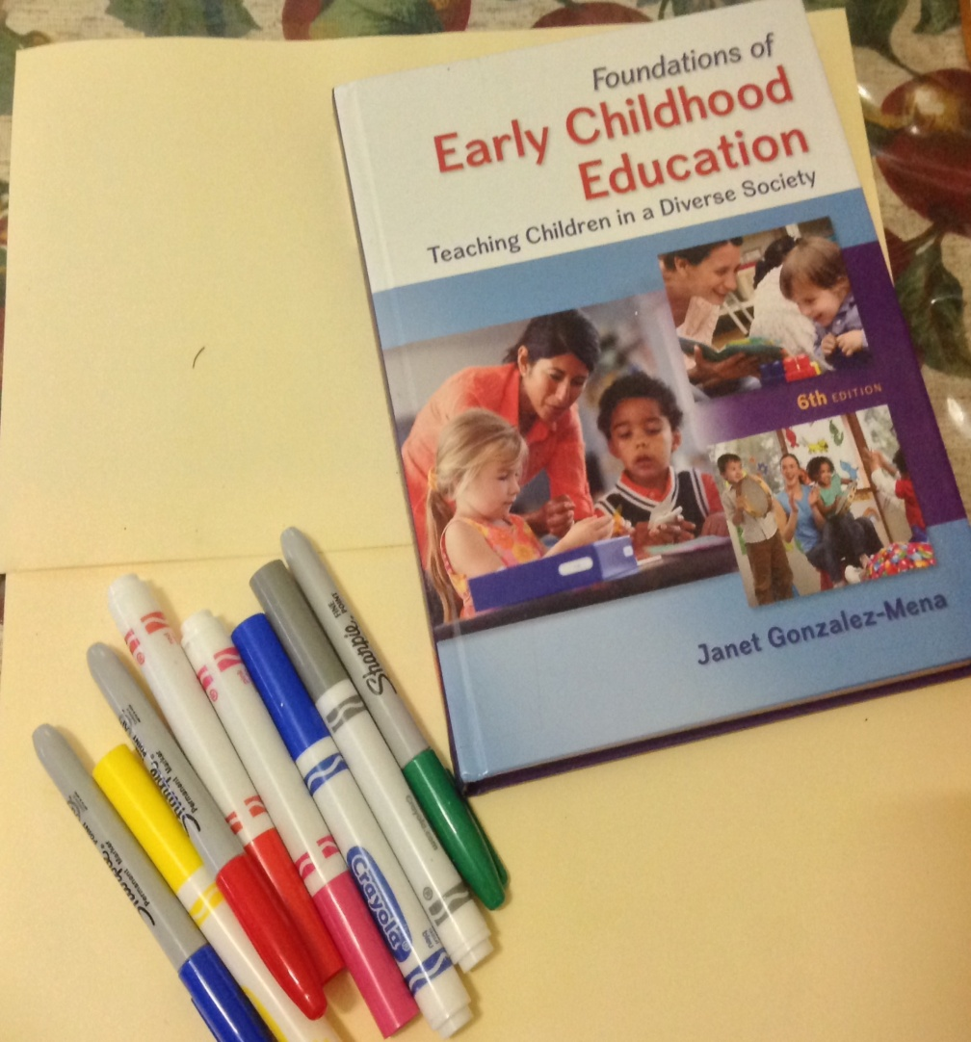
Classifying Books
Teachers
. Mature books
. Curriculum books
. Charts
. Supplies

Slide 13
Books inventory
New books in a library are each even a number. The number is used to identify the book and to show the year it was given to the library.
The information is usually written in a notebook.
Other names for the book inventory are;
Accession Register
Books Registry

Slide 14
Books Inventory
Here is an example of a books inventory.
Acc. No | Author | Book Title | Publisher | Colour Code | Source | Price, if lost
18-2016 | Ron, Roy | The lazy Lizard | Scholastic | Blue | Hands Across the sea | 5.00

Slide 15
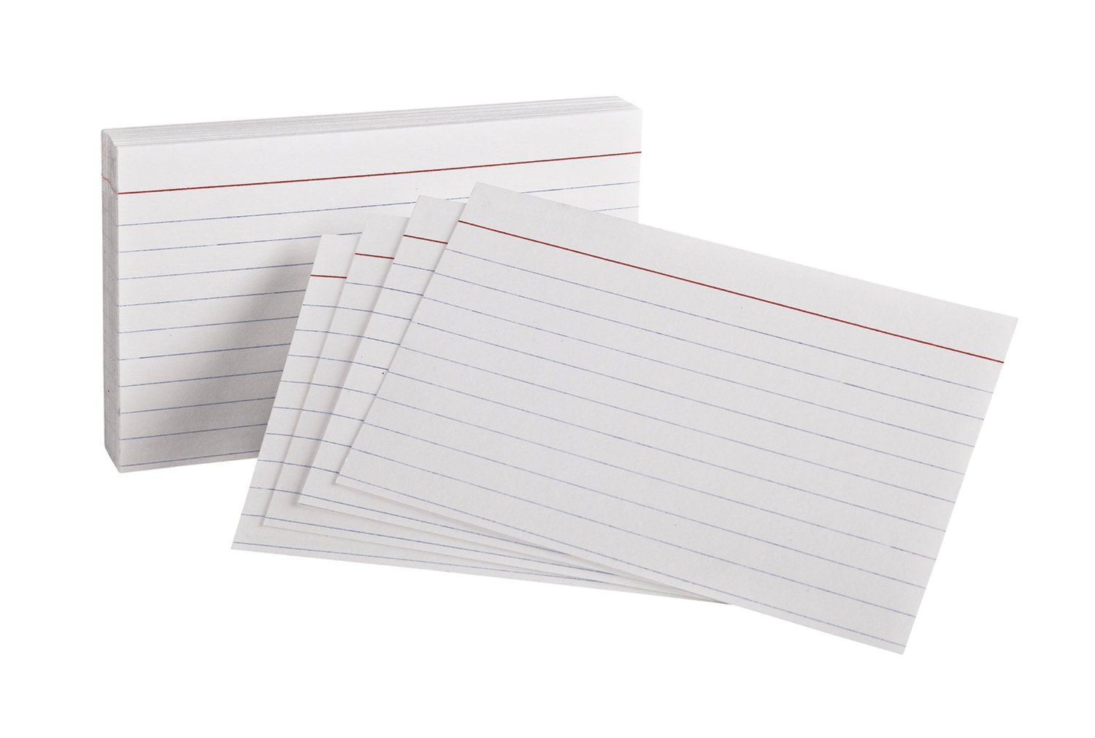
Check out System
The Checkout system should Be simple. Individual index cards can be given to each student. Which would be used to record books borrowed. It can also be used to provide a history of the students reading patterns

Slide 16

Care of the Books

Slide 17

Parts of A Book

Slide 18
Skills and Attitudes:
*Reliable * Punctual, *Careful *Friendly Manner *Shows Initiative *Good Communication Skills *Enjoys Books and Reading *Able to Follow Rules and *Hard-working *Respectful

Slide 19
Library Rules
1. Leave food and drinks on the check-in shelf.
2. Whisper and use inside voice when talking.
3. Students are not allowed to play or loiter.
4. Place books in the Books to Shelve box, and not
back on the shelve.
5. Respect librarians, teachers and students.

Slide 20

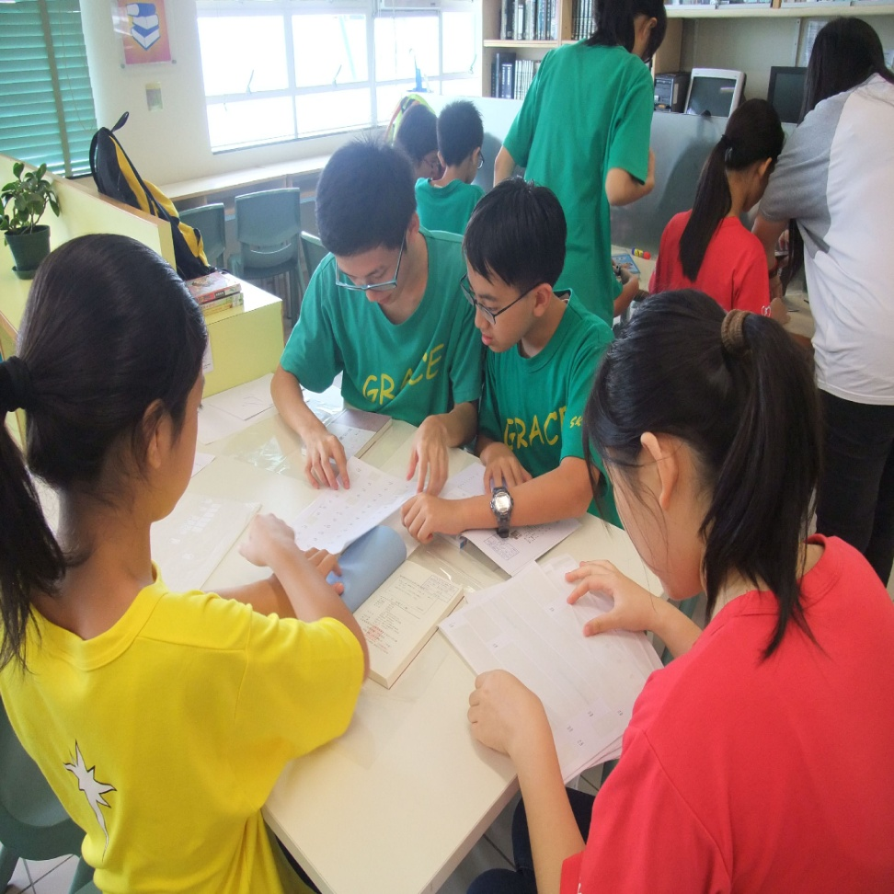
Working in the Library
1. Show up for your shift on time.
2. Put on your library badge and return it to the drawer at the end of your shift.
3. Help students and teachers find books.
4. Spend 5 mins. Sweeping and dusting.
5. Return books to their sections from the Books to Shelve Box
6. Check books In and Out to students and teachers.
7. Tidying the shelves

Slide 21

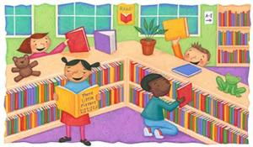
Reading in the Library
When students use books in the library but are not going to check them out, they should place them in the box labeled Books to Return next to the circulation desk.

